Slide 1
Acquiring Rich Knowledge from Text†
Benjamin Grosof*
Paul Haley**
June 3, 2013
Semantic Technology & Business Conference‡
^{San Francisco, CA, USA}
* Benjamin Grosof & Associates, LLC, www.mit.edu/~bgrosof/
** Automata, Inc., paul@haleyai.com
† Work partly supported by Vulcan, Inc., http://www.vulcan.com
‡ SemTechBiz SF, http://semtechbizsf2013.semanticweb.com/
6/11/2013
© Copyright 2013 by Benjamin Grosof & Associates, LLC, and Automata, Inc. All Rights Reserved.

Slide 2
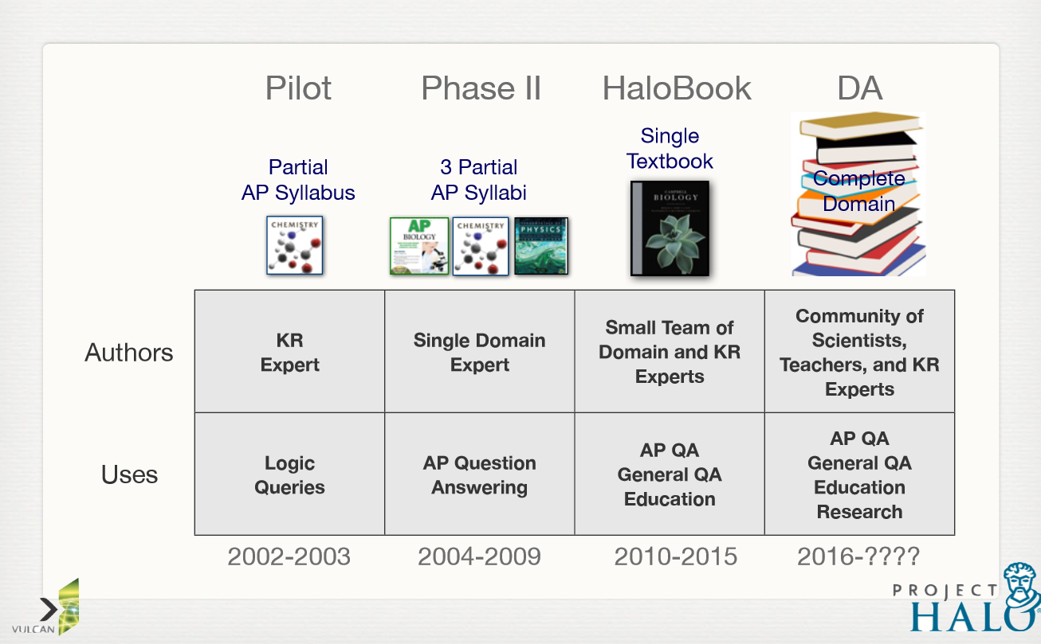
Digital Aristotle and Project Halo
Gunning et al, AAAI & IAAI (August 2011)

Slide 3
IBM Watson FAQ on QA using logic or NLP
Classic knowledge-based AI approaches to QA try to logically prove an answer is correct from a logical encoding of the question and all the domain knowledge required to answer it. Such approaches are stymied by two problems:
  the prohibitive time and manual effort required to acquire massive volumes of knowledge and formally encode it as logical formulas accessible to computer algorithms, and
  the difficulty of understanding natural language questions well enough to exploit such formal encodings if available.
Techniques for dealing with huge amounts of natural language text, such as Information Retrieval, suffer from nearly the opposite problem in that they can always find documents or passages containing some keywords in common with the query but lack the precision, depth, and understanding necessary to deliver correct answers with accurate confidences.
Notes:
E.g., see http://blogs.plos.org/retort/2011/02/14/how-ibm%E2%80%99s-watson-computer-will-excel-at-jeopardy/, which links to IBM Watson FAQs.

Slide 4
Why not QA using logic and NLP?
What if it was “cheap” to acquire massive volumes of knowledge formally encoded as logical formulas?
What if it was “easy” to understand natural language questions well enough to exploit such formal encodings?

Slide 5
Knowledge Acquisition for Deep QA: Expt.
Goal 1: represent the knowledge in one chapter of a popular college-level science textbook, at 1st-year college level
  Chapter 7 on cell membranes, in Biology 9th ed., by Campbell et al
Goal 2: measure what KA productivity is achieved by KE’s
  Assess level of effort, quality of resulting logic, and coverage of textbook
Software used in this case study:
  for translating English to logic
    Automata Linguist™ and KnowBuddy™ (patents pending)
    English Resource Grammar (http://www.delph-in.net/erg/)
  for knowledge representation & reasoning
    Vulcan, Inc.’s SILK (http://www.projecthalo.com/): prototype implementation of Rulelog

Slide 6
Summary of Effort & Results
Captured 3,000+ sentences concerning cellular biology
  hundreds of questions (2 examples herein)
  600 or so sentences directly from Campbell’s Biology textbook
  2,000 or so sentences of supporting or background knowledge
Sentence length averaged 10 words up to 25 words
  background knowledge tends to be shorter
  disambiguation of parse typically requires a fraction of a minute
  hundreds of parses common, > 30 per sentence on average
  the correct parse is typically not the parse ranked best by statistical NLP
Sentences disambiguated and formalized into logic in very few minutes on average
  resulting logic is typically more sophisticated than skilled logicians typically produce
Collaborative review and revision of English sentences, disambiguation, and formalization approximately doubled time per sentence over the knowledge base

Slide 7
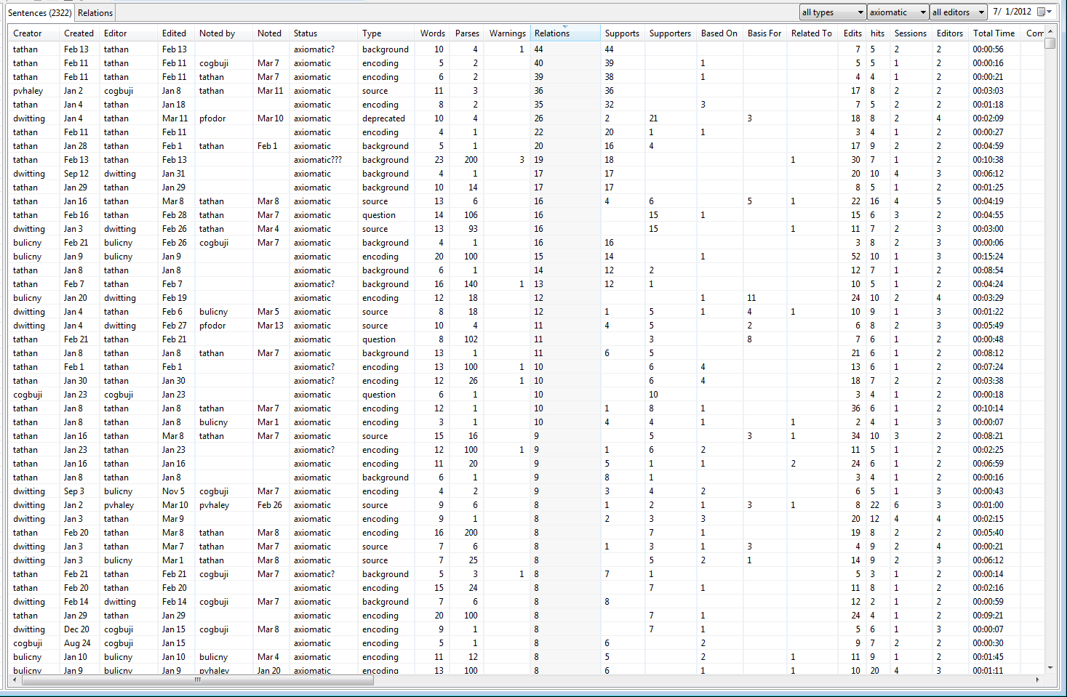
Tracked effort & collaboration per sentence

Slide 8
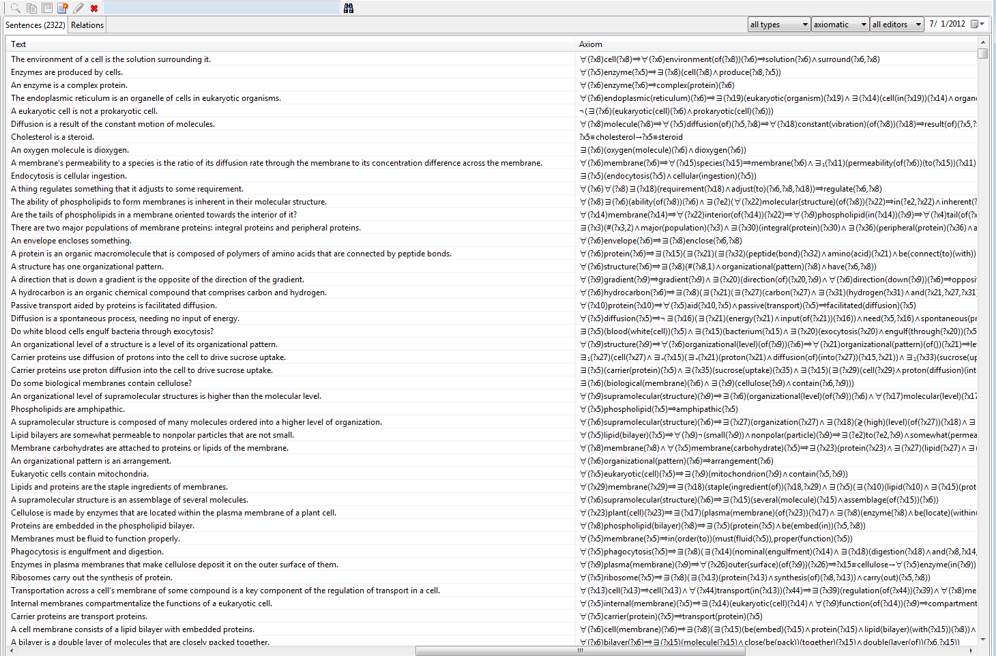
Sentences translated from English to logic

Slide 9
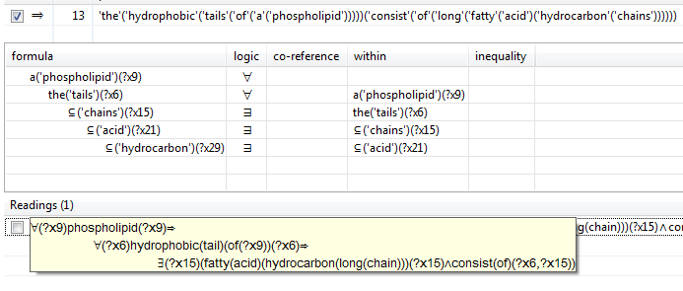
Knowledge Acquisition
Note: the “parse” ranked first by machine learning techniques is usually not the correct interpretation

Slide 10
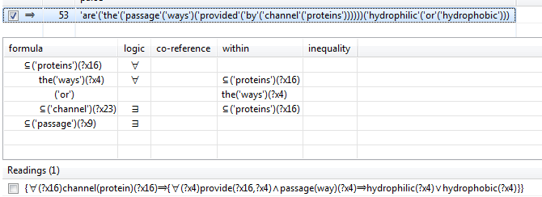
Query Formulation
Are the passage ways provided by channel proteins hydrophilic or hydrophobic?
Notes:
Note the correct parse was ranked 53rd.
In the disambiguation UI panel: “channel” and “passage” are nouns that are being used as modifiers, so their quantification is moot.

Slide 11
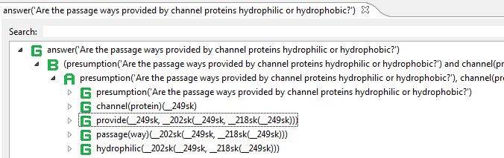
The Answer is “Hydrophilic”
Hypothetical query uses “presumption” below
Presumption yields tuples with skolems
The answer is on the last line below
Notes:
There is a presumption part of the hypothetical query: i.e., that a passage way is provided by a channel protein.
In inferencing: the presumption is asserted, then the narrow query – i.e., hydrophilic or hydrophic – is executed, then the presumption is unasserted.

Slide 12
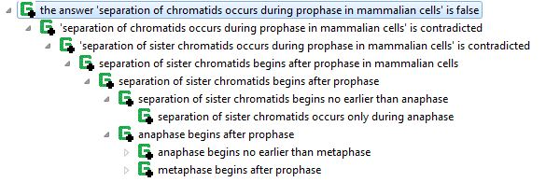
Logic to text (not focal in KA experiment)
Notes:
The above was from before the KA experiment: textual entailment reasoning that motivated the TL KA experiment.
We will be getting back to this (text generation, e.g., for explanation), in future.

Slide 13
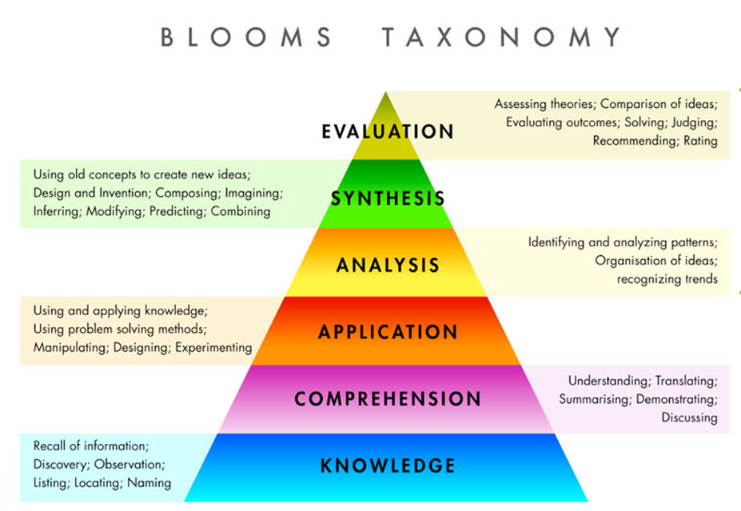
Notes:
http://www.mybrightbox.co.za/blooms_taxonomy.jpg
6 point scale, objective is to go up the stack.
Google is basically at the bottom, Watson is near the bottom.
We are aiming for near the middle.

Slide 14
A Bloom level 4 question
If a Paramecium swims from a hypotonic environment to an isotonic environment, will its contractile vacuole become more active?
∀(?x9)paramecium(?x9)
⇒∃(?x13)(hypotonic(environment)(?x13)
∧∃(?x21)(isotonic(environment)(?x21)
∧∀₁(?x31)contractile(vacuole)(of(?x9))(?x31)
⇒if(then)(become(?x31,more(active)(?x31)),swim(from(?x13))(to(?x21))(?x9))))
  The above formula is translated into a hypothetical query, which answers “No”.
Notes:
The formula is complicated looking.
Who would want to write that? And who could write it reliably and quickly?
Not even highly trained KE’s.
The software is competent, makes it easy for ordinary KE’s, and is faster and more reliable for everybody.
And the resulting logic is more efficient at run-time, due to automatic optimizations.
E.g., here: the conflation of “hypotonic” with “environment” avoids a join, ensures subgoals are sufficiently bound, and reduces word-sense ambiguity (in “environment”).
Plus it constructs a new term in the logical ontology.

Slide 15
Textual Logic Approach: Overview
Logic-based text interpretation & generation, for KA & QA
  Map text to logic (“text interpretation”): for K and Q’s
  Map logic to text (“text generation”): for viewing K, esp. for justifications of answers (A’s)
  Map based on logic
Textual terminology – phrasal style of K
  Use words/word-senses directly as logical constants
  Natural composition: textual phrase ↔ logical term
Interactive logical disambiguation technique
  Treats: parse, quantifier type/scope, co-reference, word sense
  Leverages lexical ontology – large-vocabulary, broad-coverage
  Initial restriction to stand-alone sentences – “straightforward” text
    Minimize ellipsis, rhetoric, metaphor, etc.
  Implemented in Automata Linguist™
Leverage defeasibility of the logic
  For rich logical K: handle exceptions and change
    Incl. for NLP itself: “The thing about NL is that there’s a gazillion special cases” [Peter Clark]
Notes:
The blue elements are novel.
“Gettysburg” principle: “logic for the text, of the text, by the text”.
Also wrt initial straightforward: nominal coreference is intra-sentential for now.

Slide 16
Requirements on the logical KRR for KA of Rich Logical K
The logic must be expressively rich – higher order logic formulas
  As target for the text interpretation
The logic must handle exceptions and change, gracefully
  Must be defeasible
  = K can have exceptions, i.e., be “defeated”, e.g., by higher-priority K
  For empirical character of K
  For evolution and combination of KB’s. I.e., for social scalability.
  For causal processes, and “what-if’s” (hypotheticals, e.g., counterfactual)
  I.e., to represent change in K and change in the world
Inferencing in the logic must be computationally scalable
  Incl. tractable = polynomial-time in worst-case
  (as are SPARQL and SQL databases, for example)
Notes:
I.e., the logic must be deftly nuanced (handle exceptions) and resiliently agile (handle change).
Another way to say: handle exceptions and change, gracefully.

Slide 17
Past Difficulties with Rich Logical K
KRR not defeasible & tractable
… even when not target of text-based KA
E.g.
  FOL-based – OWL, SBVR, CL: infer garbage
    Perfectly brittle in face of conflict from errors, confusions, tacit context
  E.g., FOL and previous logic programs: run away
    Recursion thru logical functions

Slide 18
Rulelog: Overview
First KRR to meet central challenge:
defeasible + tractable + rich
New rich logic: based on databases, not classical logic
  Expressively extends normal declarative logic programs (LP)
  Transforms into LP
  LP is the logic of databases (SQL, SPARQL) and pure Prolog
    Business rules (BR) – production-rules -ish – has expressive power similar to databases
  LP (not FOL) is “the 99%” of practical structured info management today
RIF-Rulelog in draft as industry standard (W3C and RuleML)
Associated new reasoning techniques to implement it
Prototyped in Vulcan’s SILK
  Mostly open source: Flora-2 and XSB Prolog
Notes:
Xquery (XML databases) is also LP. Event-condition-action (ECA) rules are production-rule -ish.
Wrt raising the abstraction level: the higher-level (Rulelog) is good for KA, the lower-level (LP) is good for implementation.
BR adds fine-grain reactivity.

Slide 19
Rulelog: more details
Defeasibility based on argumentation theories (AT) [Wan, Grosof, Kifer 2009]
  Meta-rules (~10’s) specify principles of debate, thus when rules have exceptions
  Prioritized conflict handling. Ensures consistent conclusions. Efficient, flexible, sophisticated defeasibility.
Restraint: semantically clean bounded rationality [Grosof, Swift 2013]
  Leverages “undefined” truth value to represent “not bothering”
  Extends well-foundedness in LP
Omniformity: higher-order logic formula syntax, incl. hilog, rule id’s
  Omni-directional disjunction. Skolemized existentials.
  Avoids general reasoning-by-cases (cf. unit resolution).
Sound interchange of K with all major standards for sem web K
  Both FOL & LP, e.g.: RDF(S), OWL-DL, SPARQL, CL
Reasoning techniques based on extending tabling in LP inferencing
  Truth maintenance, justifications incl. why-not, trace analysis for KA debug, term abstraction, delay subgoals
Notes:
The semantic interchange is (in general) incomplete due to restraint and avoiding general reasoning-by-cases.
K interchange with FOL is sound despite non-monotonicity.
Other lesser expressive features: aggregation (SQL -ish); external queries, actions, events (reactivity); frame syntax.
Combines several deep discoveries.
Restraint generalizes well-foundedness in LP.
Hidlog = hilog + rule id’s.
“Hidlog” is pronounced “high-dee-log”. ISO Common Logic and SBVR employ hilog.
External queries, actions, and events: cf. reactiveness in BR. Frame syntax is “object-oriented” and is cf. F-Logic.
Tabling is a family of LP inferencing techniques. Termination is ensured by the tabling techniques (together with restraint).
Meta-rules can help extract justifications from the reasoner.
Implementation also includes some Java, esp. for UI.
CL = ISO Common Logic. SBVR uses CL.

Slide 20
TL KA – Study Results
Axiomatized ~2.5k English sentences during 2013:
  One defeasible axiom in Rulelog (SILK syntax) per sentence
  On average, each of these axioms correspond to > 5 “rules”
    e.g., “rule” as in logic programs (e.g., Prolog) or business rules (e.g., PRR, RIF-PRD)
<< 10 minutes on average to author, disambiguate, formalize, review & revise a sentence
The coverage of the textbook material was rated “A” or better for >95% of its sentences
Collaboration resulted in an average of over 2 authors/editors/reviewers per sentence
Non-authors rated the logic for >90% of sentences as “A” or better; >95% as “B+” or better
TBD: How much will TL effort ↑ during QA testing?
TBD: How much will TL effort ↓ as TL tooling & process mature?

Slide 21
TL KA – Study Results (II)
    Expressive coverage: very good, due to Rulelog
      All sentences were representable but some (e.g., modals) are TBD wrt reasoning
      This and productivity were why background K was mostly specified via TL
      Small shortfalls (< few %) from implementation issues (e.g., numerics)
    Terminological coverage: very good, due to TL approach
      Little hand-crafted logical ontology
      Small shortfalls (< few %) from implementation issues
      Added several hundred mostly domain-specific lexical entries to the ERG

Slide 22
TL KA: KE labor, roughly, per Page
    (In the study:)
    ~~$3-4/word (actual word, not simply 5 characters)
    ~~$500-1500/page (~175-350 words/page)
    Same ballpark as: labor to author the text itself
    … for many formal text documents
      E.g., college science textbooks
      E.g., some kinds of business documents
      “Same ballpark” here means same order of magnitude
    TBD: How much will TL effort ↑ when K is debugged during QA testing?
    TBD: How much will TL effort ↓ as its tooling & process mature?

Slide 23
KA Advantages of Approach
Approach = Textual Logic + Rulelog
Interactive disambiguation: relatively rapidly produces rich K
  With logical and semantic precision
  Starting from effectively unconstrained text
Textual terminology: logical ontology emerges naturally
  From the text’s phrasings, rather than needing effort to specify it explicitly and become familiar with it
  Perspective: Textual terminology is also a bridge to work in text mining and “textual entailment”
Rulelog as rich target logic
  Can handle exceptions and change, and is tractable
Rulelog supports K interchange (translation and integration)
  Both LP and FOL; all the major semantic tech/web standards (RDF(S), SPARQL, OWL, RIF, CL, SBVR); Prolog, SQL, and production rules. (Tho’ for many of these, with restrictions.)

Slide 24
Conclusions
Research breakthrough on two aspects:
1. rapid acquisition of rich logical knowledge
2. reasoning with rich logical knowledge
Appears to be significant progress on the famous “KA bottleneck” of AI
  “Better, faster, cheaper” logic. Usable on a variety of KRR platforms.
It’s early days still, so lots remains to do
  Tooling, e.g.: leverage inductive learning to aid disambiguation
  More experiments, e.g.: push on QA; scale up
Notes:
Also a direction: Textic: interweave textual syntax and logical syntax.

Slide 25
recap: Scalable Rich KA – Requirements
Defeasible
+ Tractable
Text-based
KA & QA
Logic
KRR
Disambig.

Slide 26
recap: Scalable Rich K – Approach
Textual Logic
Text-based KA & QA
Defeasible + Tractable
Argumentation theories
Restraint
Omniform
Rulelog
Logic-based map
of text ←→ logic
Logic
KRR
Textual terminology
Interactive disambiguation
Notes:
Rulelog more details: incremental tabling, abstract justification graph, reasoning trace analysis.

Slide 27
Apps
Resources
Specialized UI
Service
interfaces
Textual Logic
Text-based & KA QA
Databases
Services
Defeasible + Tractable
Argumentation theories
Restraint
Omniform
Rulelog
Logic-based map
of text ←→ logic
Logic
KRR
Textual terminology
Interactive disambiguation
Usage Context for Approach

Slide 28
Late-Breaking News
Company created to commercialize approach
Coherent Knowledge Systems
(coherentknowledge.com went live today)
Target markets: policy-centric, NL QA and HCI
Notes:
Also a direction: Textic: interweave textual syntax and logical syntax.

Slide 29
Acknowledgements
    This work was supported in part by Vulcan, Inc., as part of the Halo Advanced Research (HalAR) program, within overall Project Halo. HalAR included SILK.
    Thanks to:
      The HalAR/SILK team
      The Project Sherlock team at Automata
      The Project Halo team at Vulcan
      RuleML and W3C, for their cooperation on Rulelog

Slide 30
Thank You
Disclaimer: The preceding slides represent the views of the author(s) only.
All brands, logos and products are trademarks or registered trademarks of their respective companies.
6/11/2013
© Copyright 2013 by Benjamin Grosof & Associates, LLC, and Automata, Inc. All Rights Reserved.

